Slide 1
Welcome!
DESIGNED BY MICHAEL PANAIT FOR HACK CLUB ARCADE
REPLACE (school’s) Hack Club with your Hack Club’s Name!
Feel free to modify anything in this presentation file.
(Your School) Hack Club - OnBoard Meeting
Workshop 1 - Hacker Card - Session 1

Slide 2
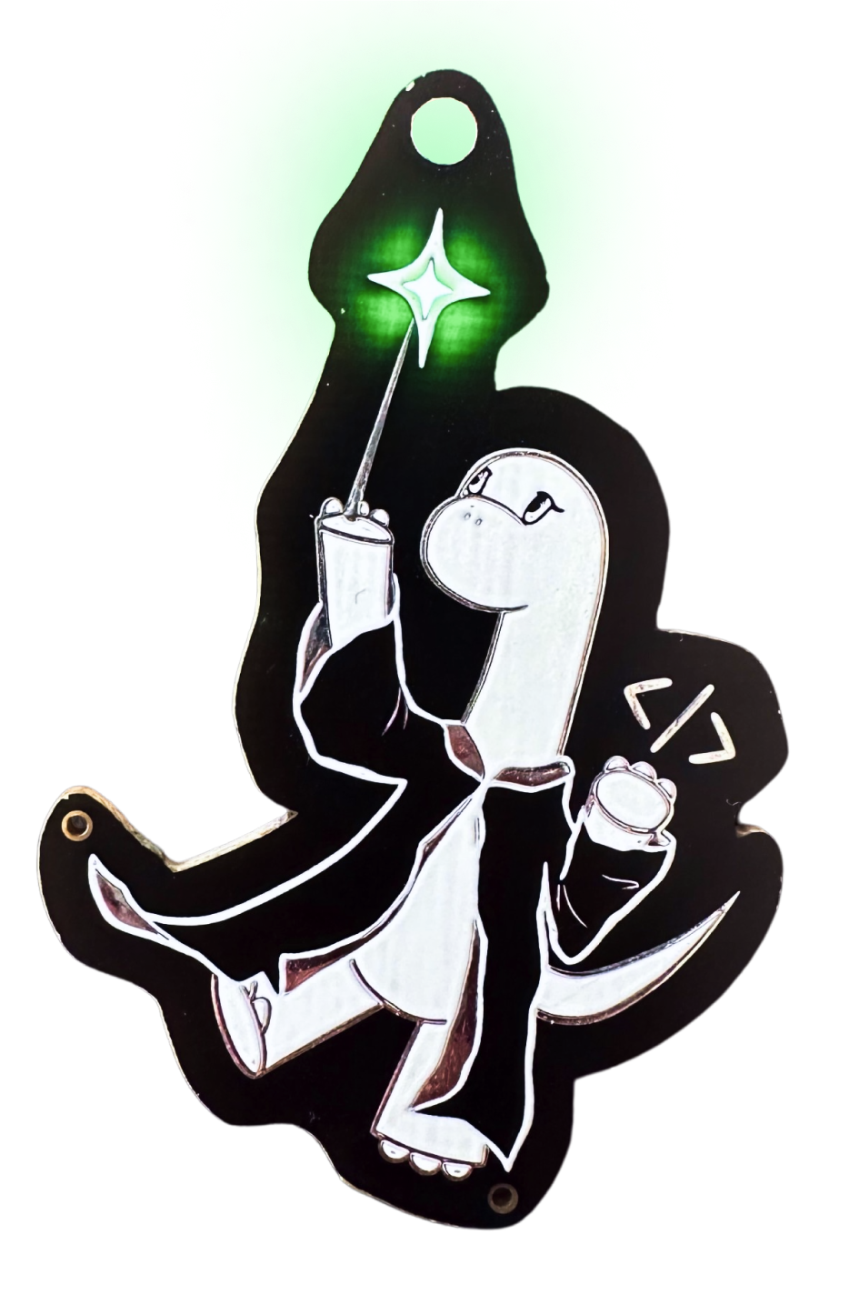
Welcome to OnBoard!
This will be the first Hack Club workshop of this semester! After this, you should receive $100 to put your card into production and build another project for the Spring Ship!
This will be split into 4 sessions - 25 minutes each
Intro to EasyEDA and Schematic Design
EasyEDA PCB Design
EasyEDA PCB Design: Adding a spin!
Submitting your project to JLCPCB and OnBoard

Slide 3
What will we be learning?
Basic Electrical Engineering
PCB Routing and Design
Schematics
Forks, Pushing/Pulling, and Requests in GitHub

Slide 4
Step 1: Make a EasyEDA account
Go to easyeda.com and click Design Online
Launch EasyEDA STD, do not select EasyEDA PRO,
On the top right, click “Register”
Make an account. Please DO NOT USE A SCHOOL EMAIL.
Manually or through Google is fine.

Slide 5
Step 2: Create an EasyEDA Project
Under “Quick Start”, select “New Project”
Set your project title to NFC Hacker Card
Hit “Save”
Now, we’ll show you the rest!

Slide 6
More coming soon!

Slide 7
Thanks for coming!
See you at the next meeting on ________ (08/XX/2X)
Grab a sticker on the way out!

